Slide 1
Notes:
Welcome.

Slide 2
HAVE YOU EVER THOUGHT ABOUT DIRECTING YOUR OWN MOVIES?
Notes:
Have you ever thought about directing your own movies?

Slide 3
HAVE YOU EVER WANTED TO STIMULATE YOUR CREATIVITY BUT DIDN’T KNOW EXACTLY HOW?
Notes:
Have you ever wanted to stimulate your creativity but didn’t know exactly how? What if I told you there is an easy way

Slide 4
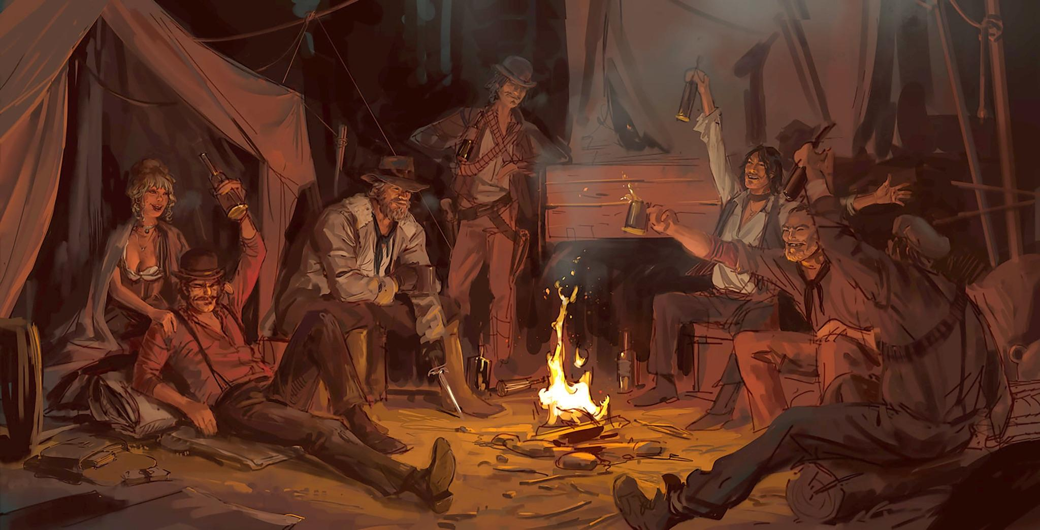
RED DEAD REDEMPTION 2—CONCEPT ART
DAREN BADER/ROCKSTAR GAMES
Notes:
What if I told you we could all gather around a campfire and tell each other stories, that we could draw.

Slide 5
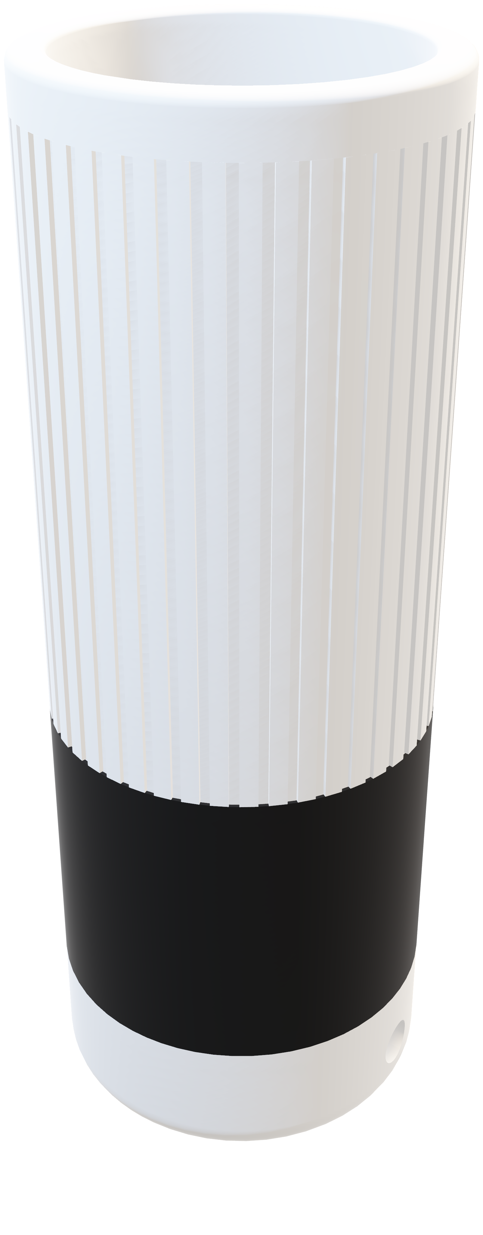
INTRODUCING
Notes:
Introducing Morpheus. Your new, AI-enabled, narrator and guide to a new world of unlimited possibilities. Today is the day you’ll cancel your streaming subscriptions, because this is your new Netflix.

Slide 6
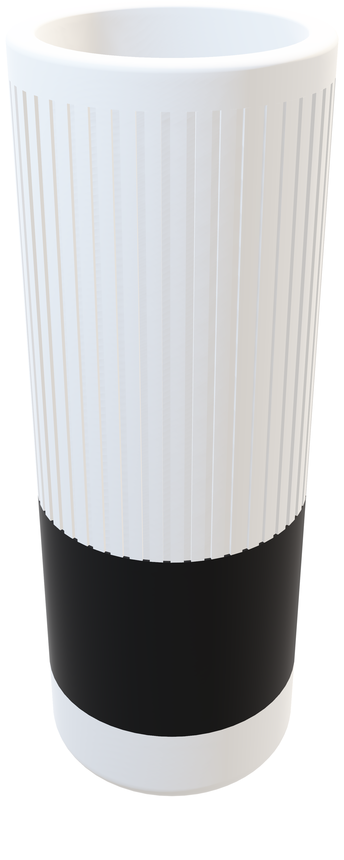
Notes:
Introducing Morpheus. Your new, AI-enabled, narrator and guide to a new world of unlimited possibilities. Today is the day you’ll cancel your streaming subscriptions, because this is your new Netflix.

Slide 7
Tutorial: How to cancel your Netflix subscription
Notes:
And for that, I have a tutorial on how to do so,

Slide 8
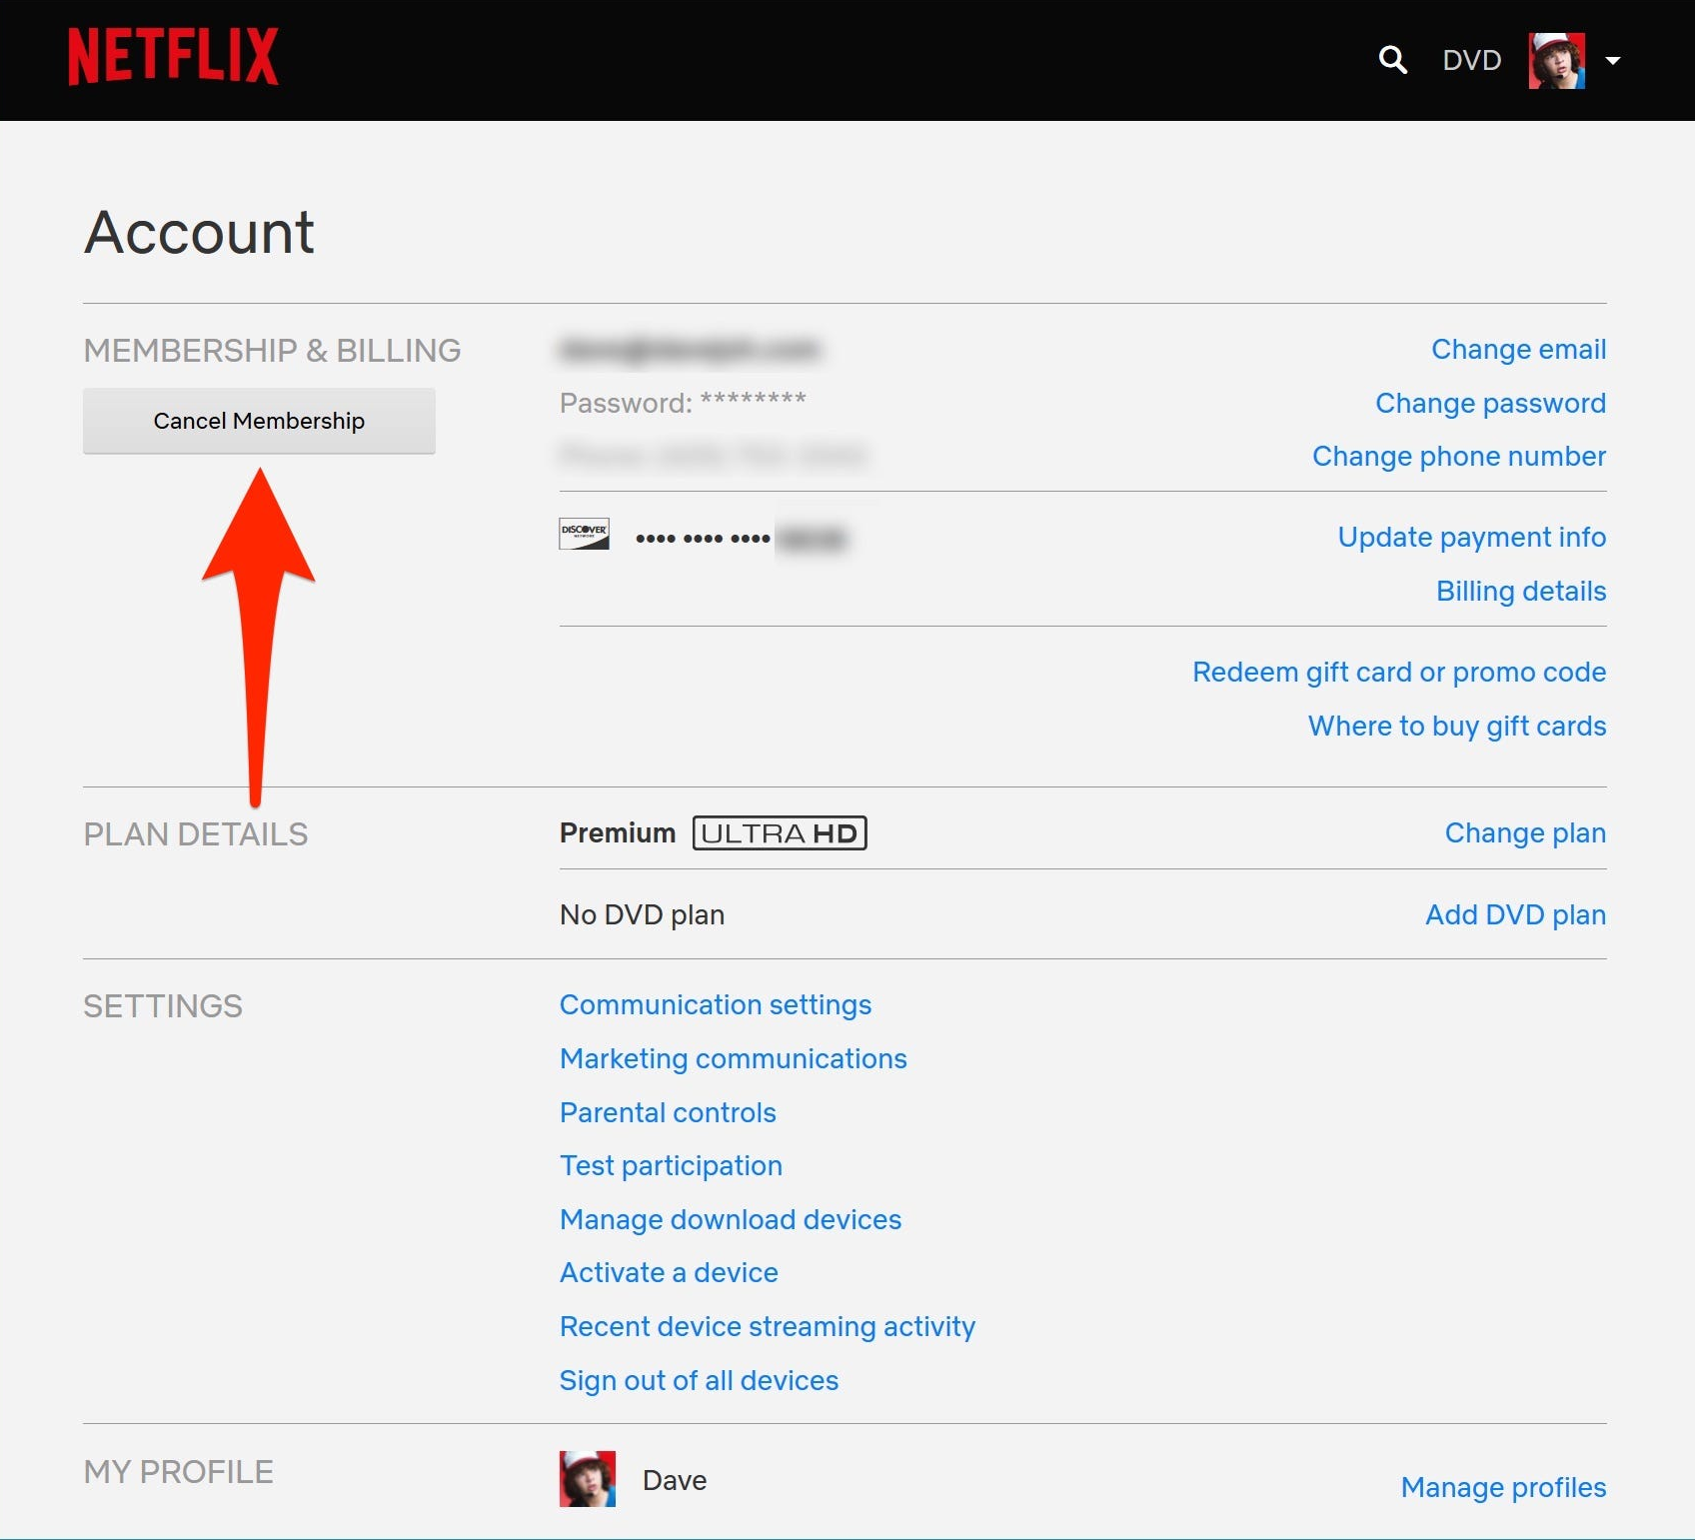
Netflix.com/cancelplan
Notes:
go to Netflix.com/cancelplan

Slide 9
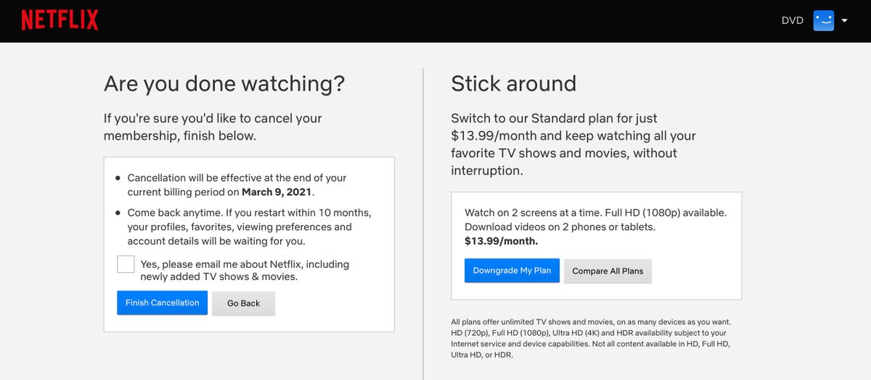
Congrats!!! You just saved 14$ a month!!!🎉
Notes:
and click on Finish Cancellation. Now back to my project.

Slide 10
AI ASSISTANT THAT NARRATES STORIES
FOR YOU WHILE DRAWING
Notes:
Morpheus is an AI assistant that narrates stories to you while drawing.

Slide 11
EPISODES AND SERIES
Notes:
Each day, you get one episode to draw and each episode can be part of a series.

Slide 12
CHIPS INSIDE OF PENS
RFID+NFC
Notes:
These stories are enabled by chips inside of pens or pencils where each pen…

Slide 13
STORY
TEXTURE
FEELING
Notes:
has its own story, texture on paper and feeling in the hand.

Slide 14
WHERE IS THE AI PART?
Notes:
Where is the AI part you’re gonna ask?

Slide 15
#INTRO
#EVENT1
Once upon a time, a small kitten called Teddy, was from the Orange Cats Village, north of Kyoto.
He left his family to embark on a journey across the world.
His boat had an engine failure, and he thought he was going to die.
Fortunately, Teddy had some mechanic skills, so he fixed his boat.
Teddy disembarked at San Francisco where he planned to visit Silicon Valley.
#EVENT2
#EVENT3
#ENDING
Notes:
Well, each time you turn on Morpheus, it’s going to generate a story based on these pre-defined tags with a scenario, that Morpheus will detail and hallucinate about.

Slide 16
#INTRO
With a knapsack brimming with dreams and a spirit ablaze with courage, Teddy bid farewell to his beloved family, ready to embark on his daring quest. His journey began with a sturdy wooden sailboat, his trusty vessel as he sailed across the tempestuous seas. The sun beat down upon his fur, the wind whispered tales of distant shores, and the waves danced with a rhythm that echoed his adventurous spirit.
#EVENT1
#EVENT2
#EVENT3
#ENDING
Notes:
Well, each time you turn on Morpheus, it’s going to generate a story based on these pre-defined tags with a scenario, that Morpheus will detail and hallucinate about.

Slide 17
#INTRO VAR 45
#EVENT1 VAR 38
#EVENT2 VAR 98
#EVENET3 VAR 23
#ENDING VAR 154
Notes:
So you could get a completely different story each time you go from one episode to the other. Even if you already started a series, what happens next is generated.

Slide 18
#INTRO VAR 45
#EVENT1 VAR 38
#EVENT2 VAR 98
#EVENET3 VAR 23
#ENDING VAR 154
Notes:
The ending of the series for example might also be different and that’s where the beauty of Morpheus comes to.

Slide 19
ALIVE STORIES
Notes:
You’re not trapped into one linear story, but one that is very much alive.

Slide 20
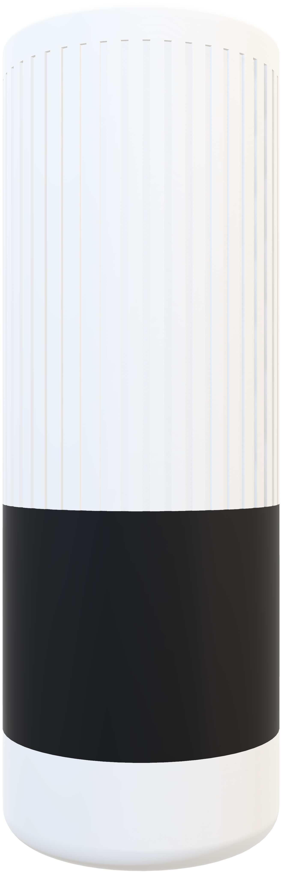
DEMO
Notes:
Let me show you how it works. I’m going to take my notebook where I already have a collection of stories.
So, you know pen holders right, you throw pens inside and if you want to use them you just simply lift one and write, pretty simple right??
Morpheus works exactly the same way. Plug it into the wall and voila, it just works.
Let’s start with a story. I’m going to lift my pen and immediately dive into this story that Morpheus will narrate to me. And you can see that even if I’m not drawing perfectly, it’s fine! There’s no need for pressure and it’s not a drawing contest.
I can also invite people to draw with me. Hey ****, do you mind joining me?
And this, now became a group activity, again just like watching TV.
I can either wait for the end of the episode, or just stop it by putting the pen back. There you go.

Slide 21
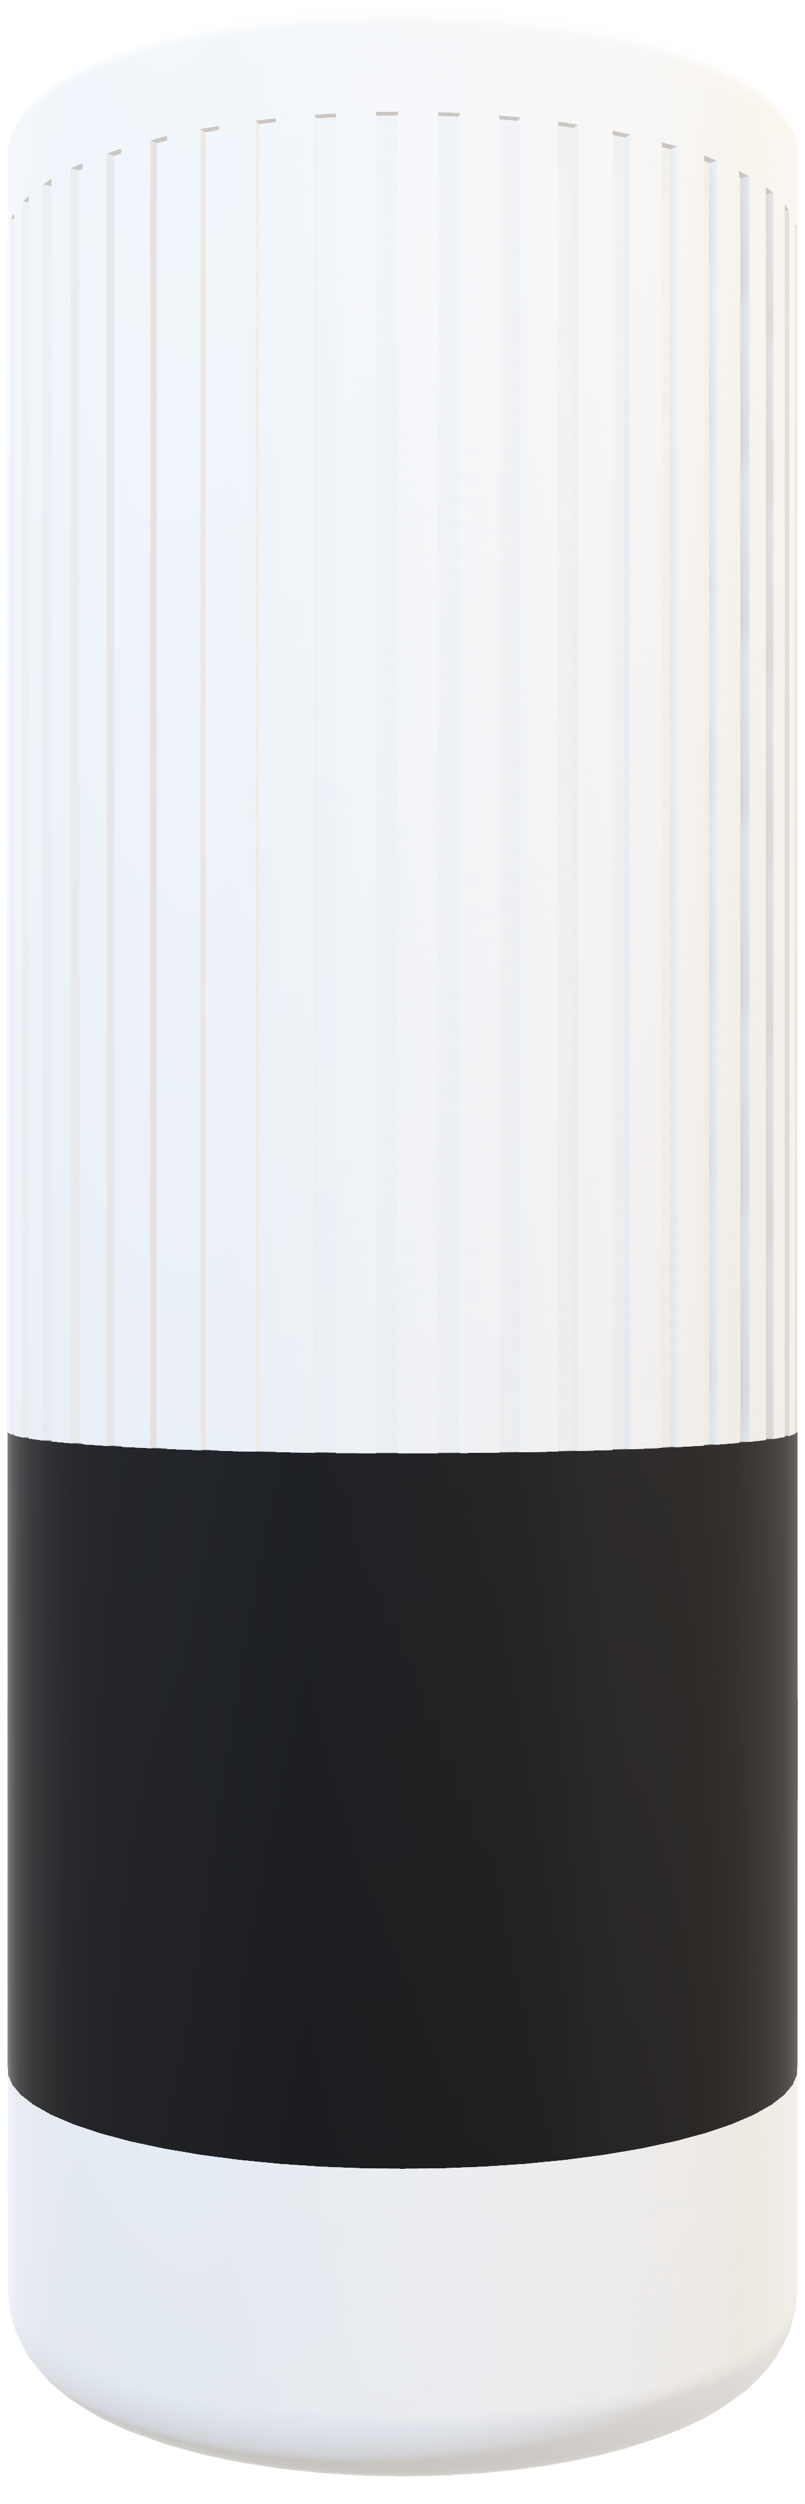
BEAUTIFUL INDUSTRIAL DESIGN
SIMPLE INTERACTION
AI-GENERATED STORIES
Notes:
So we’ve got a beautiful industrial design, a straightforward and simple interaction, and breathtaking ai-generated stories to take you on a journey to another world. This is a great device, I’m sure you’ll have fun playing with.

Slide 22
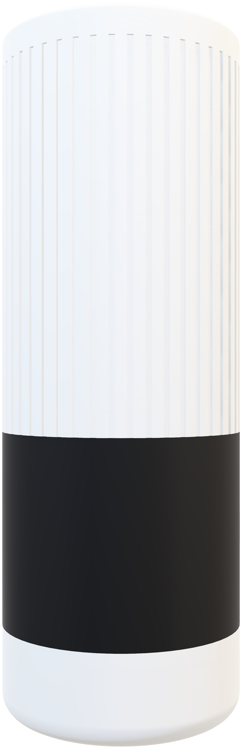
ADAM CHATIR, 2024
MASTER MEDIA DESIGN
HEAD-GENÈVE × CARAN D’ACHE
Notes:
Thank you very much.

